Slide 1
Survival Analysis of hearth disease
Presented by
Animesh Guchhait

Slide 2
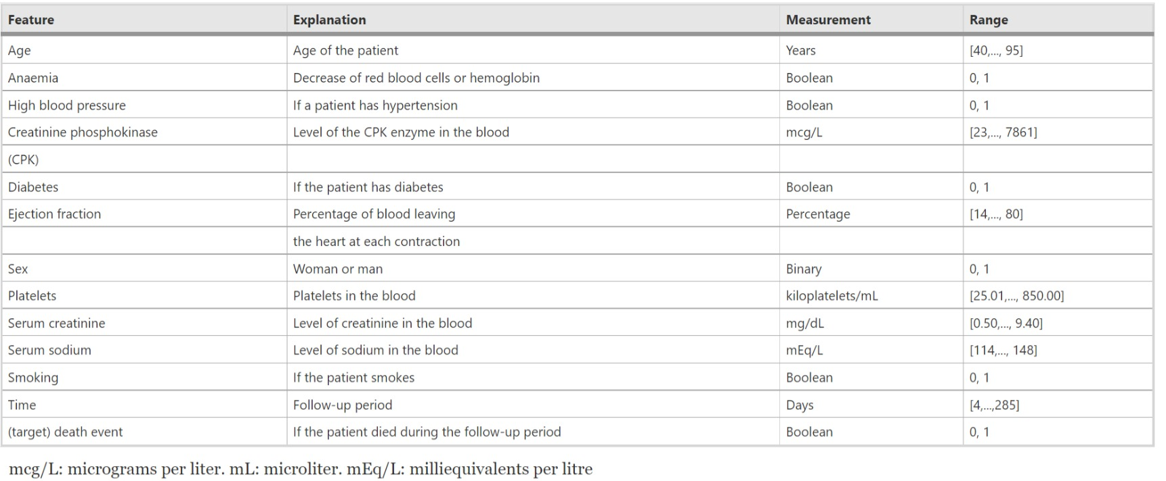
Dataset & it’s Description
Data set is collected from UCI Machine Learning Repository: Heart failure clinical records Data Set

Slide 3
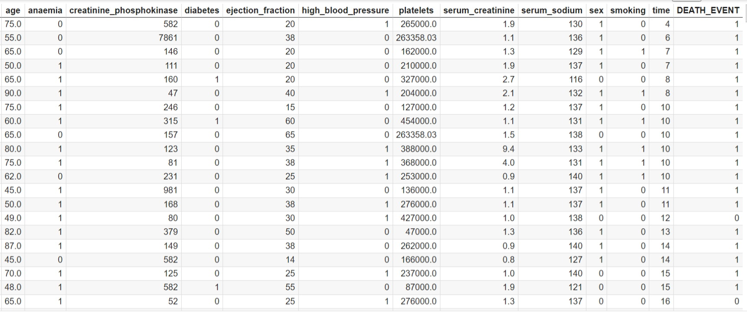
Dataset & it’s Description

Slide 4
Why do we need survival analysis instead of regression ?

Slide 5
Idea of Censoring
TIME = min ( T, C) , where T is true survival time and C is the time of censoring
DEATH_EVENT = 1 if T ≤ C
= 0 else
if a Patient died before censoring then DEATH_EVENT = 1
if a Patient dropped out the study then DEATH_EVENT = 0
if a Patient was alive when the study ended then DEATH_EVENT = 0

Slide 6
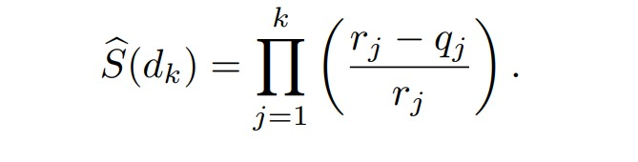
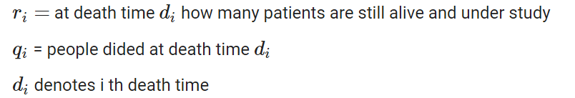
Kaplan-Meier Survival Curve
Survival curve = S(t) = Pr(T >t)
But because of Censoring , we can not use the above metioned formula directly .
where

Slide 7
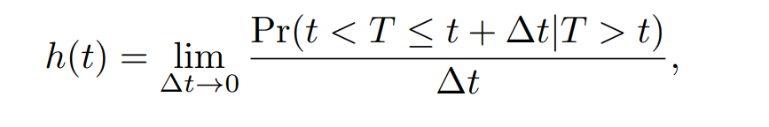
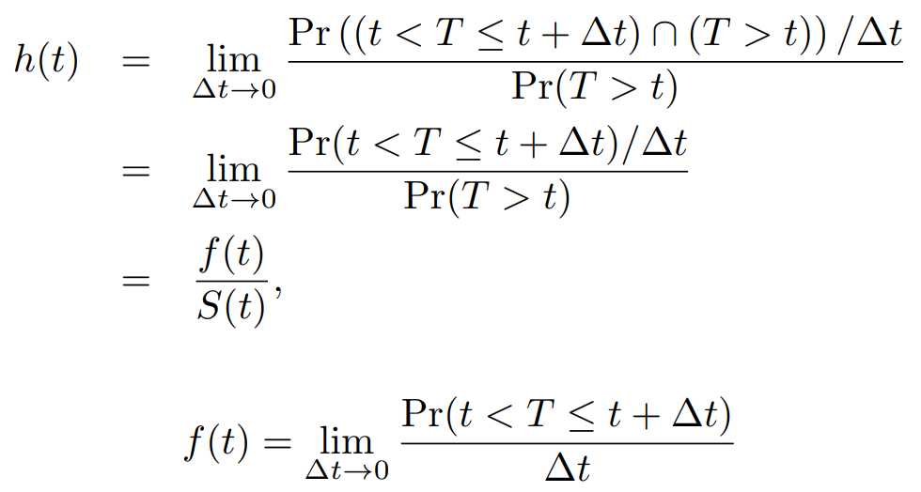
Cox’s Proportional Hazards Model
Hazard function

Slide 8
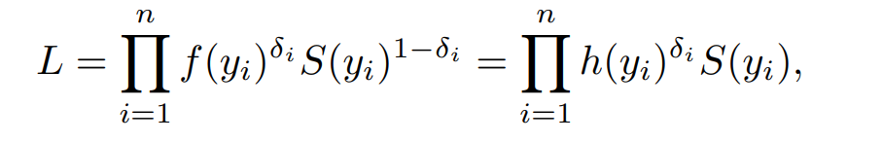

Cox’s Proportional Hazards Model

Slide 9
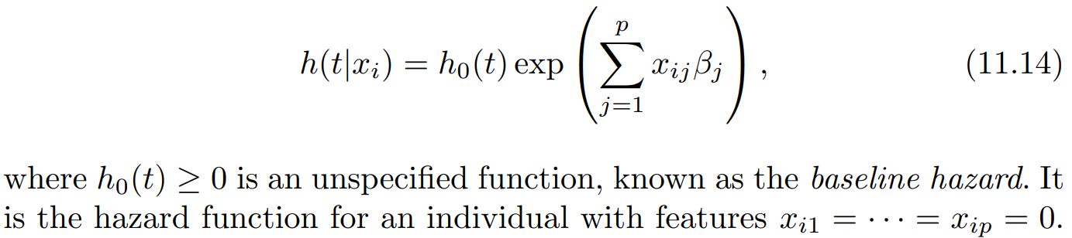
Cox’s Proportional Hazards Model
Proportional Hazard

Slide 10
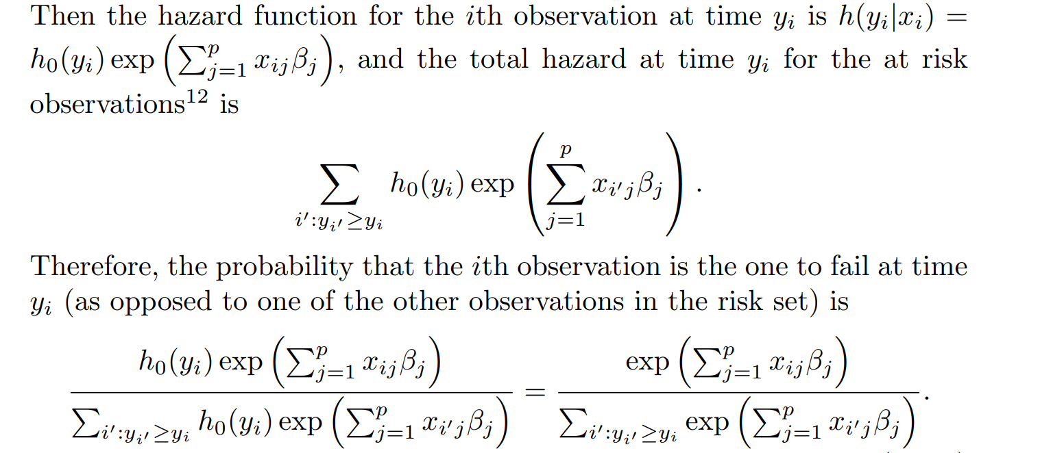
Cox’s Proportional Hazards Model

Slide 11
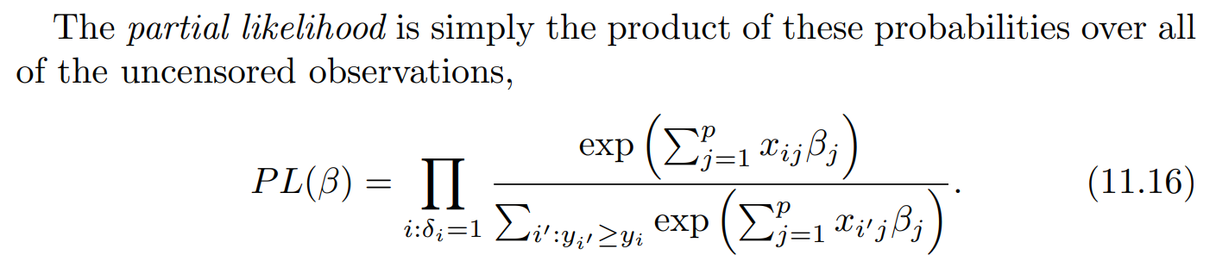
Cox’s Proportional Hazards Model

Slide 12
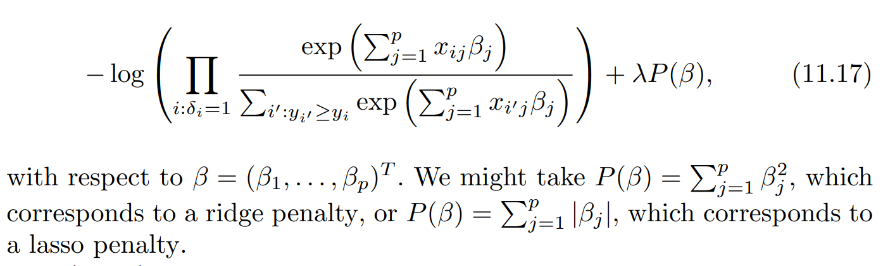
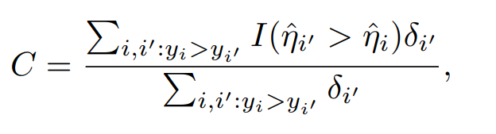
Shrinkage for the Cox Model
Minimize penalized version of negative log partial likelihood
Harrell’s concordance index (or C-index )

Slide 13
Dataset & it’s Description

Slide 14
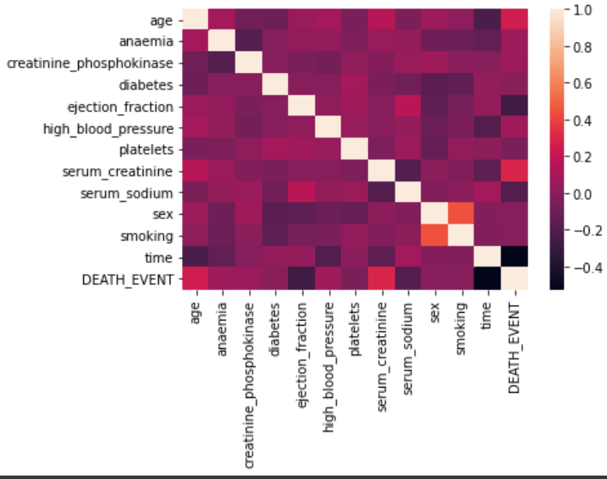
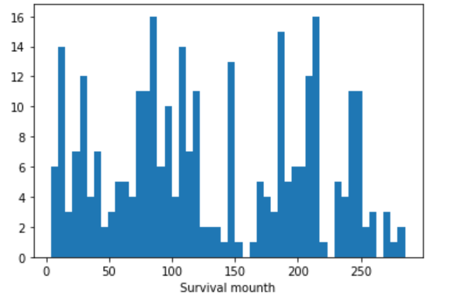

Slide 15
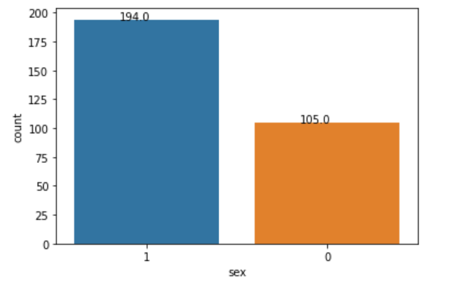
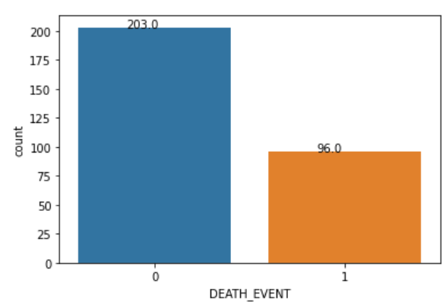
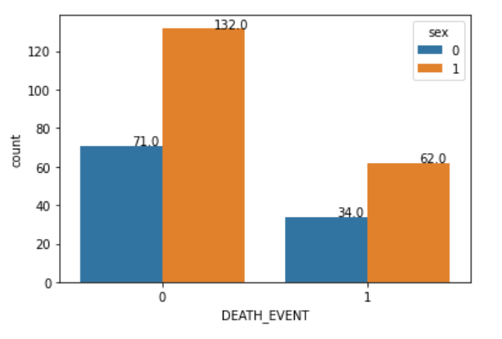

Slide 16
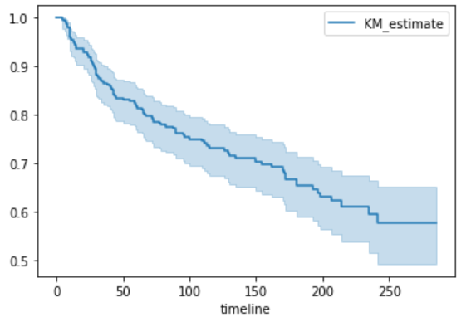
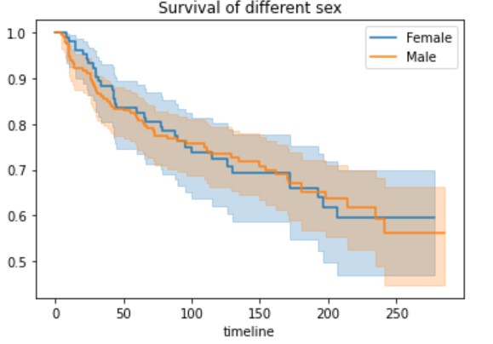
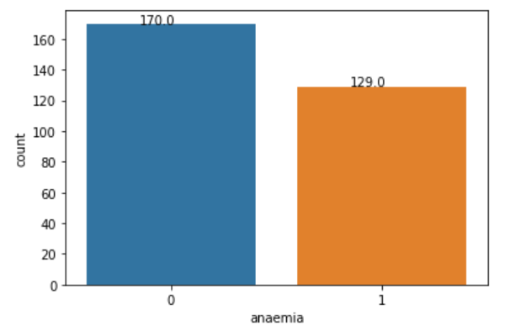
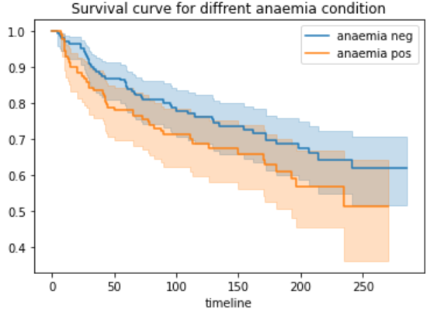

Slide 17
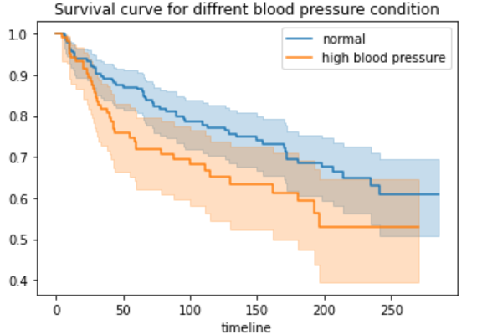
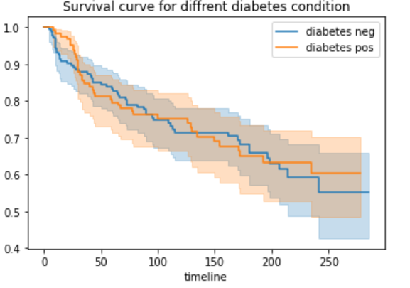

Slide 18
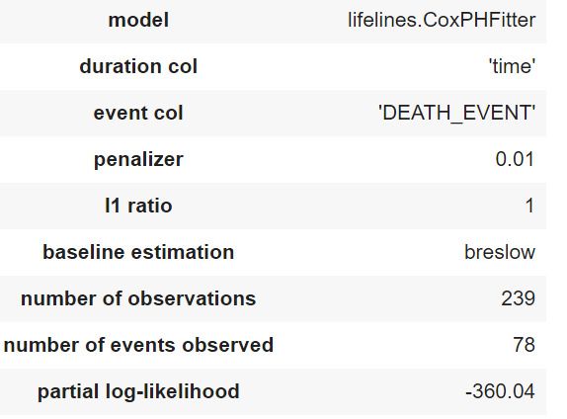
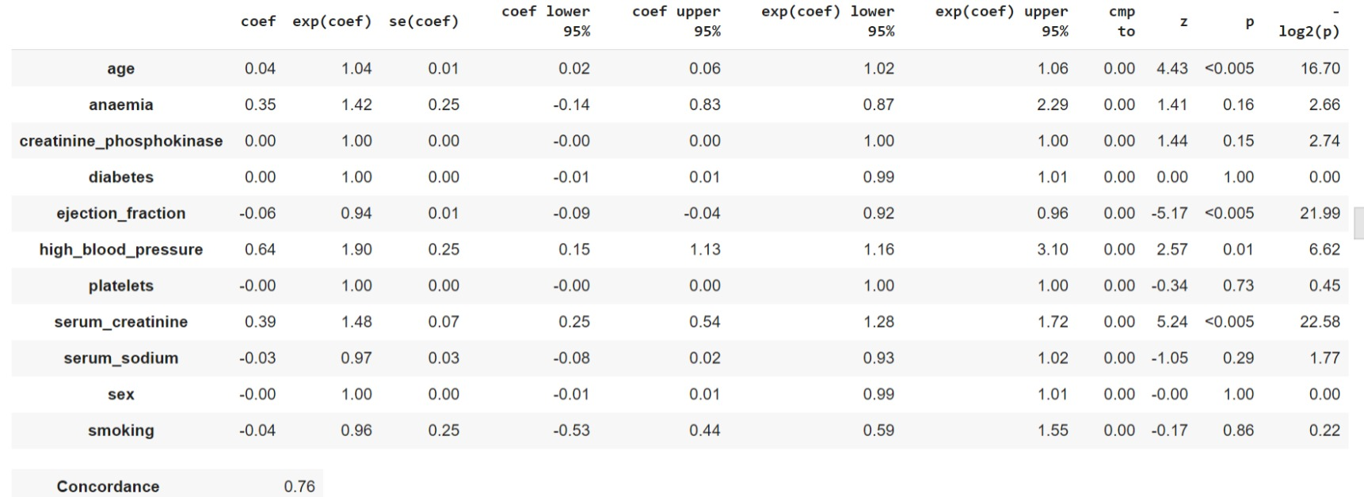
Cox’s Model summary with lasso penalty

Slide 19
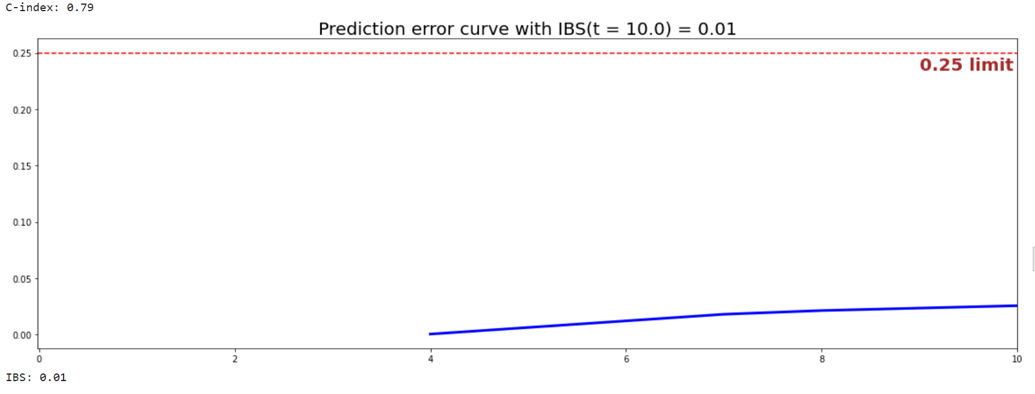
Cox’s Model c-index & ibs on test data

Slide 20
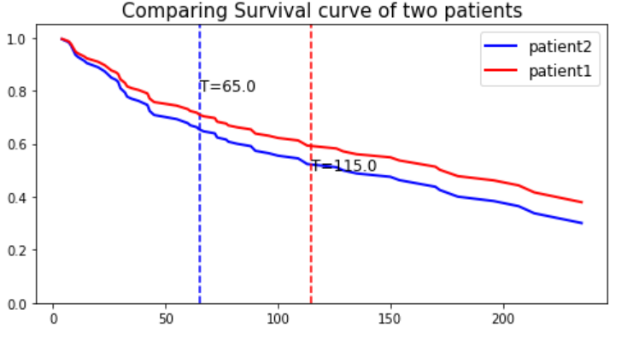

Slide 21
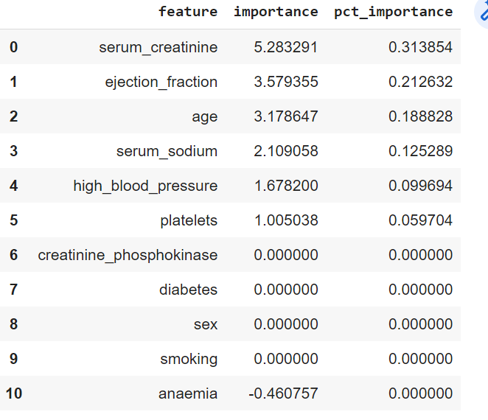
Random survival forest model
For survival tree model , C-Index on train data = 0.80
C-Index on test data = 0.77 and IBS on test data = 0.09
Detected important features for survival tree model

Slide 22
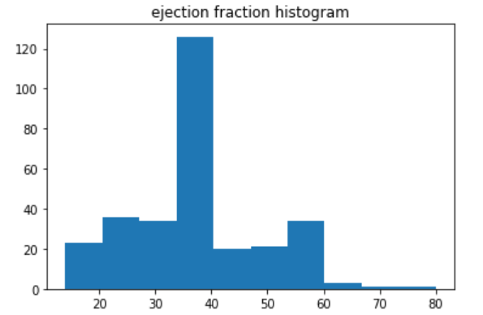
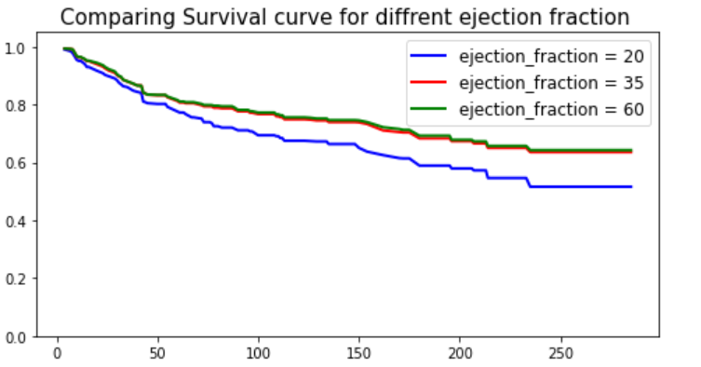
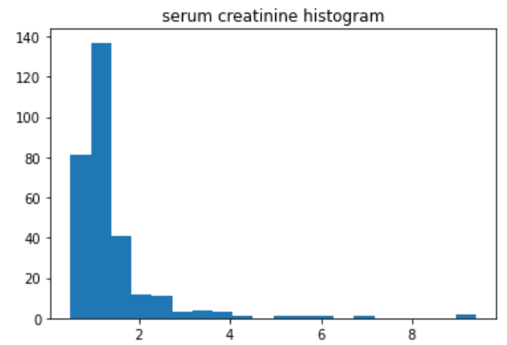
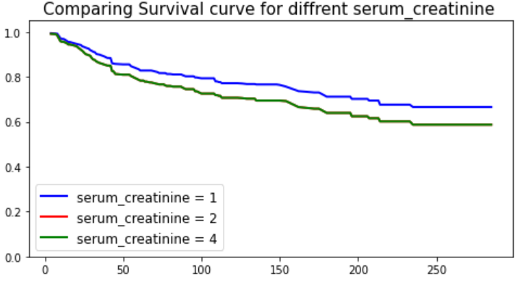

Slide 23
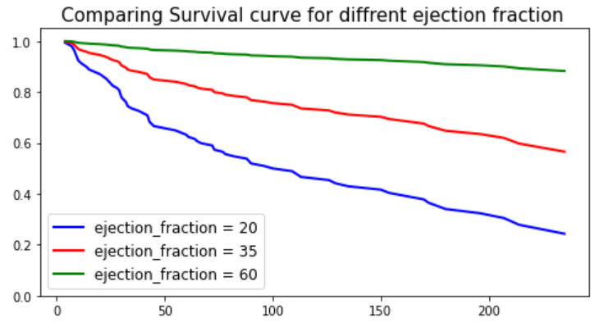
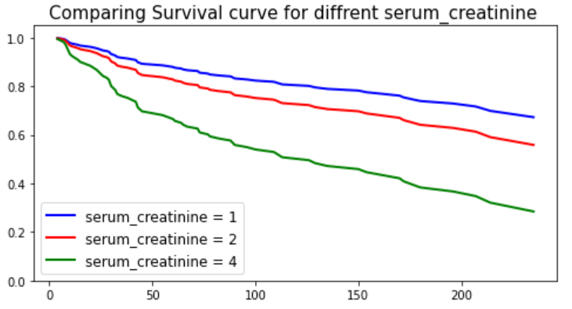
Using coxph model

